Slide 1
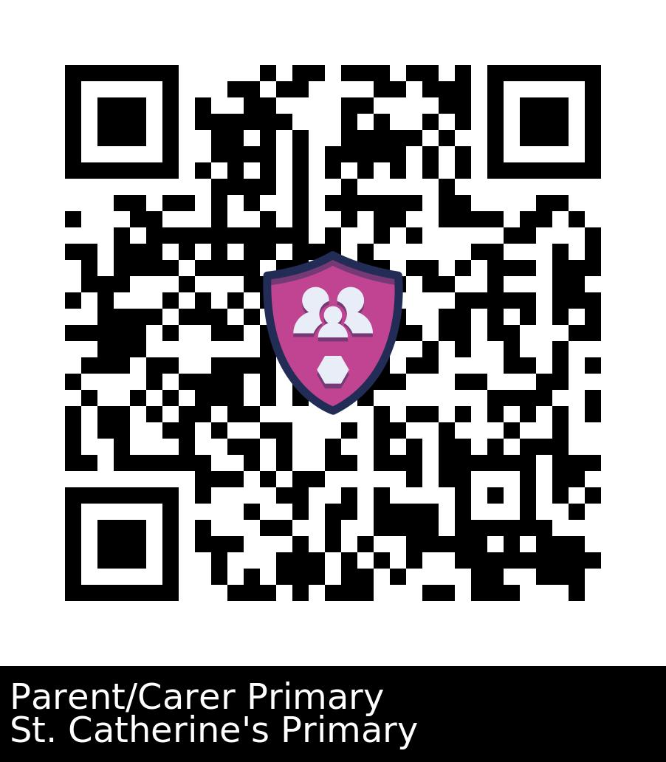
Your school logo here
Place QR
Code Here
8063

